Slide 1

Elearning website
B2111957 – Phan Trung Thuận
B2105670 – Dương Minh Khang

Slide 2
Functionalities
Instructor:
Login / Sign out
Search class
Create / Delete class
Rename class title
Create / Delete class’s cell*
Upload document file(s)
Edit homework’s expiration date
View homework report
Download / Download all student’s upload file(s)
Grade student’s homework
Student:
Login / Sign out
Search class
Join / Leave class
Upload homework file(s)
*Note: class’s cell has 2 types, which are document cell and homework cell

Slide 3
Technologies
HTML, CSS, JS
HTML templates with JavaScript [1]
PHP, MySQL
Pagination
Cookie
File upload
Fetch API + Asynchronous Communication (async + await, promise)
JSZip (JavaScript library for handling .zip files) [2]
Reference:
[1] https://gomakethings.com/html-templates-with-vanilla-javascript/#a-hybrid-approach
[2] https://stuk.github.io/jszip/

Slide 4
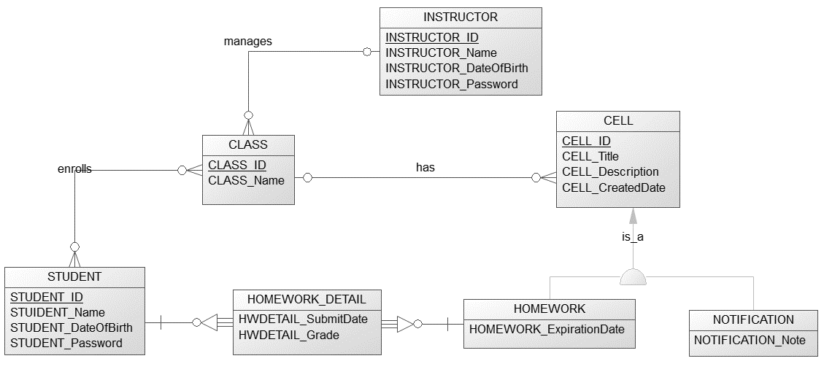
Database (CDM)

Slide 5
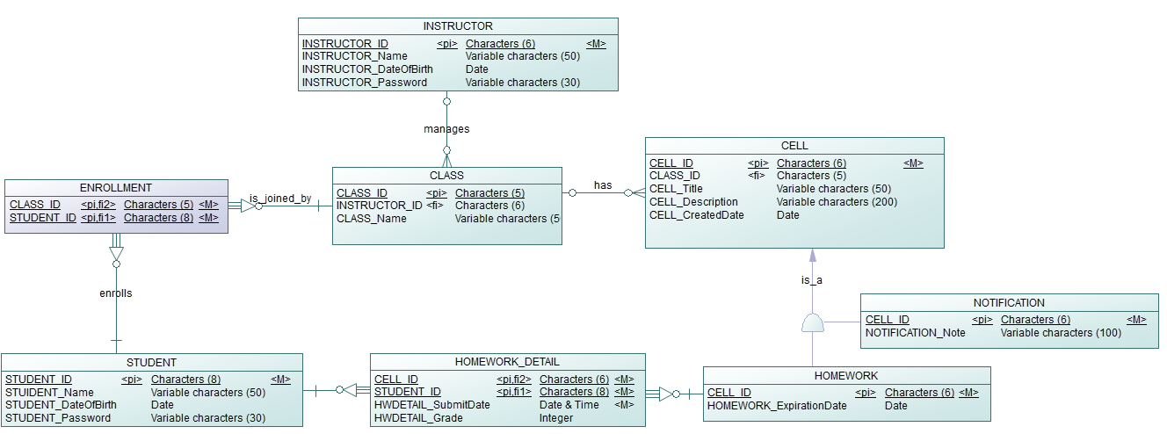
Database (LDM)

Slide 6
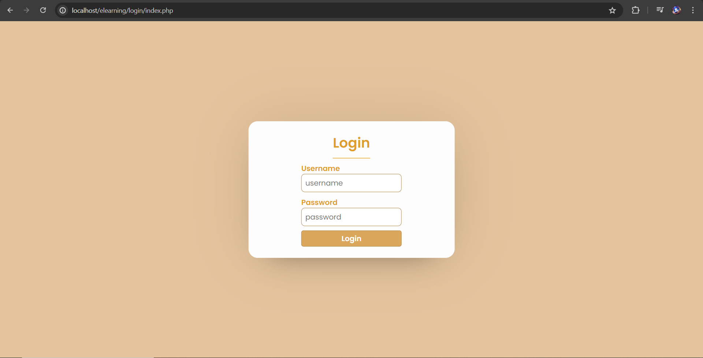
Interfaces – Login

Slide 7
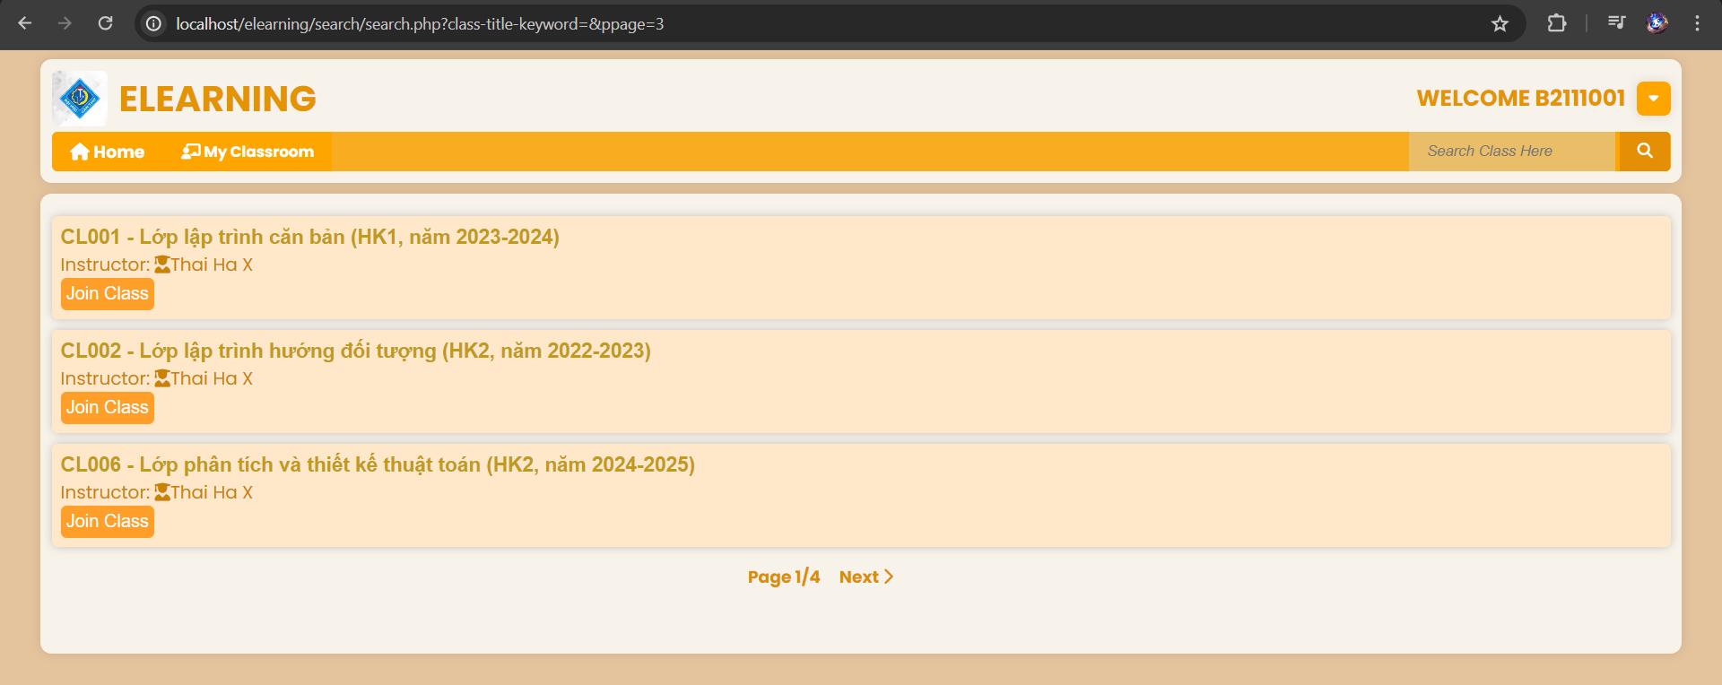
Interfaces – Search class

Slide 8
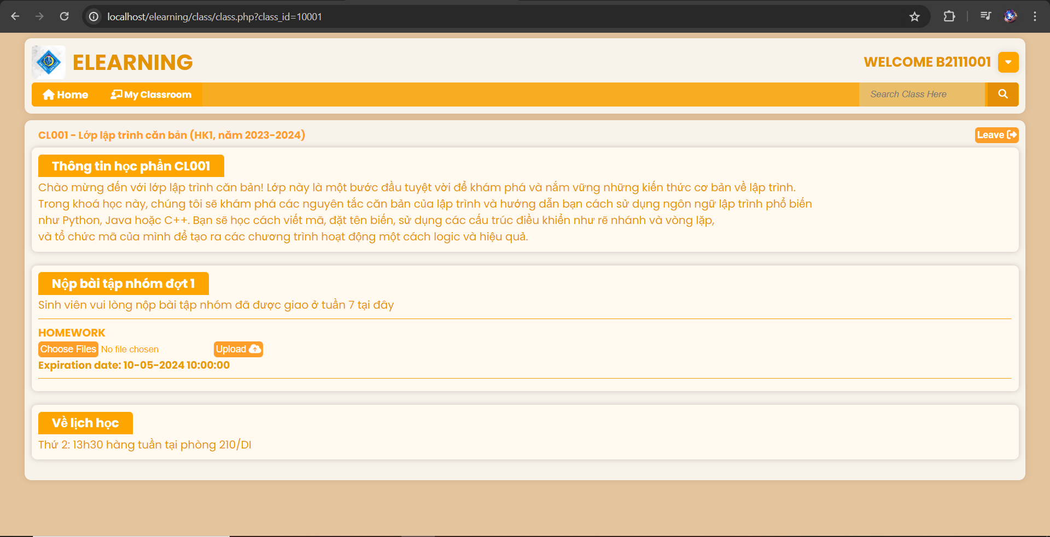
Interfaces – Class (student)

Slide 9
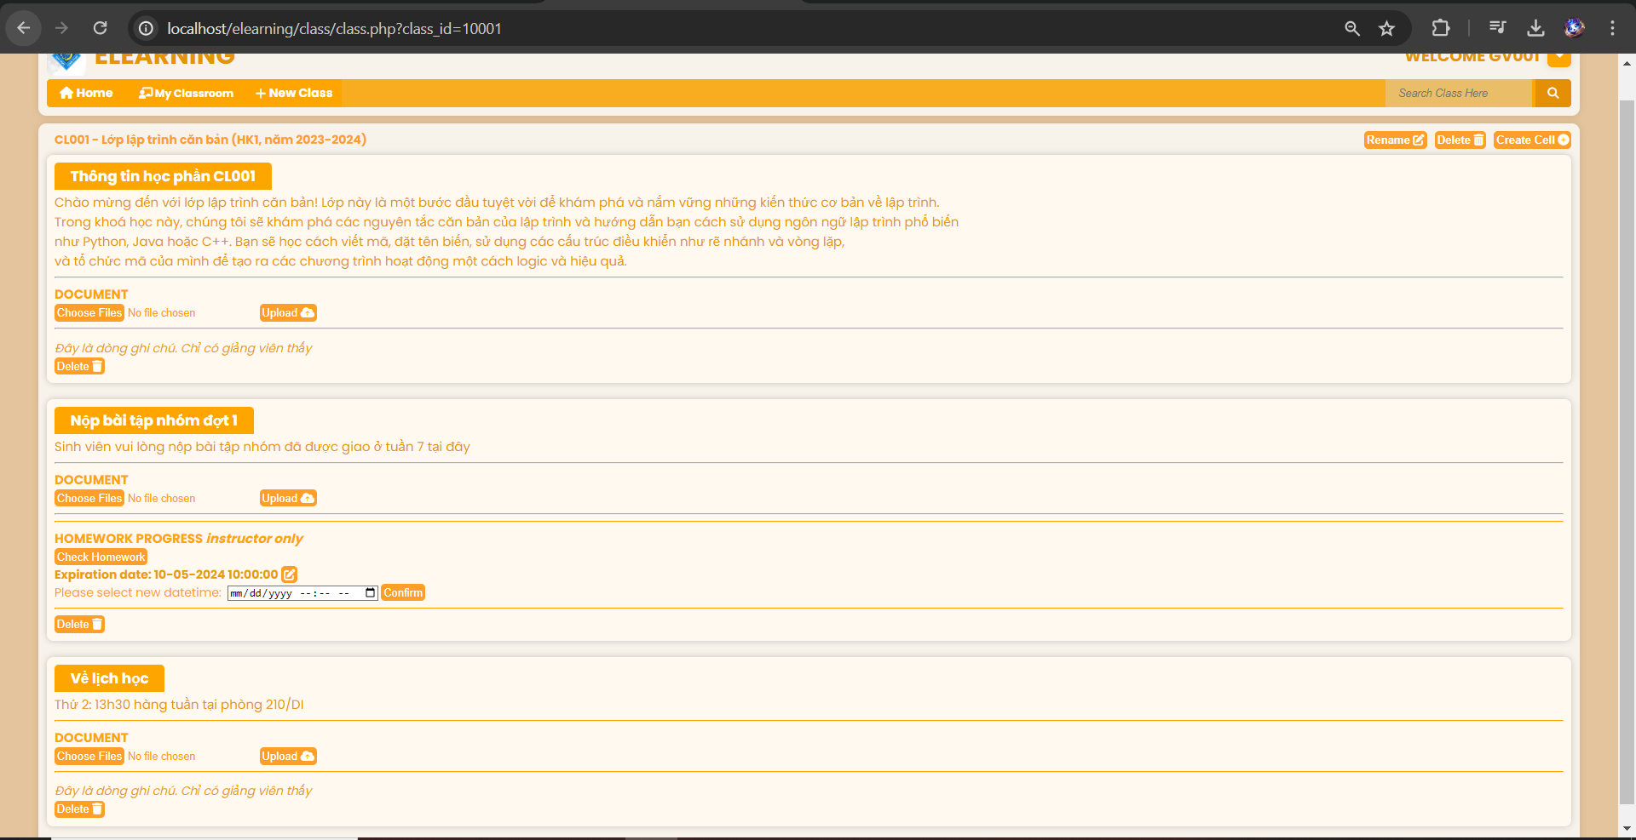
Interfaces – Class (instructor)

Slide 10
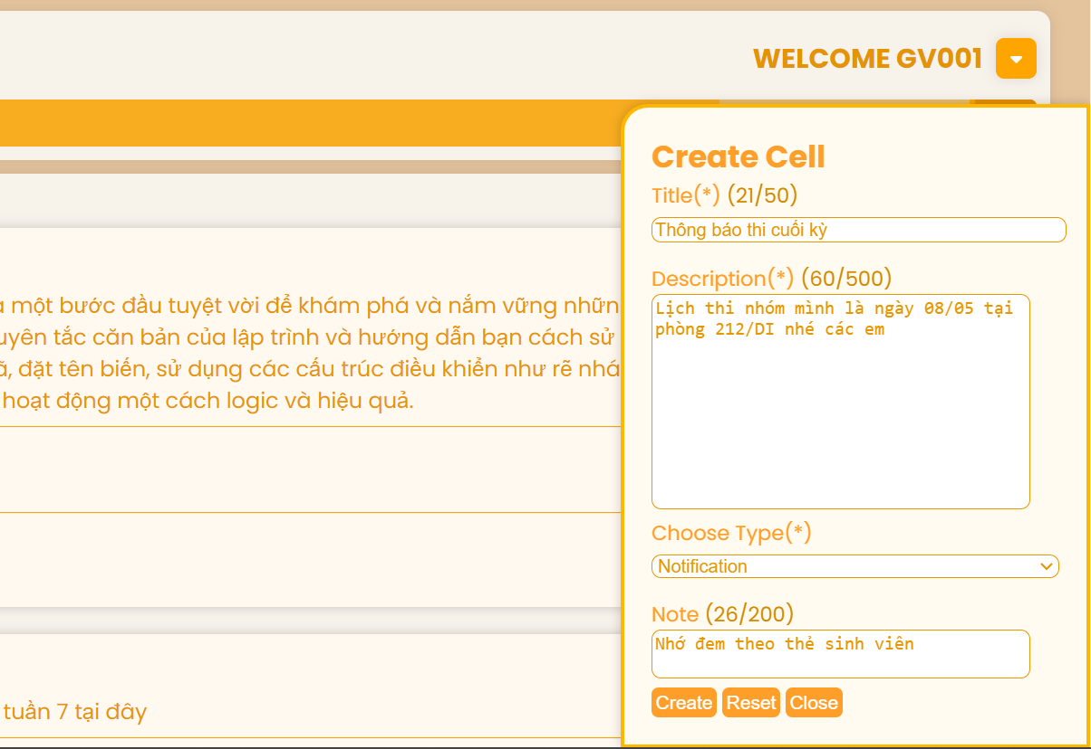
Interfaces – Create cell

Slide 11
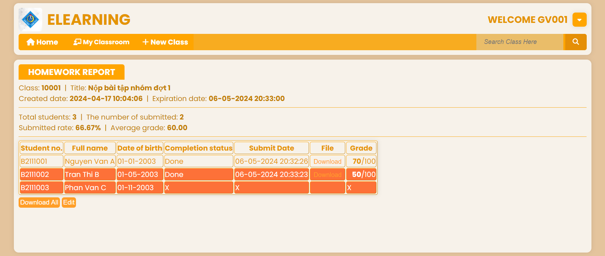
Interfaces – Homework report

